Slide 1
CS460 - Senior Design
Team 5 – Virtual Reality Research & Development
Daniel Johnson
T. Avery Eich
Asad Ashur

Slide 2
Vision statement
Virtual Reality technology and tools have become highly accessible to small teams of software engineers and artists. These teams can now produce significantly immersive experiences without the need to adopt esoteric design and implementation techniques. In light of these advancements, our team performed research on the content developers have produced over the past two years, and will utilize this research to design and implement a fully-featured VR experience.

Slide 3
outline
Hardware & Software
Research Methods
Data Entry and Analysis
Implementation Plan (Future)

Slide 4
Hardware & software
T. Avery Eich

Slide 5
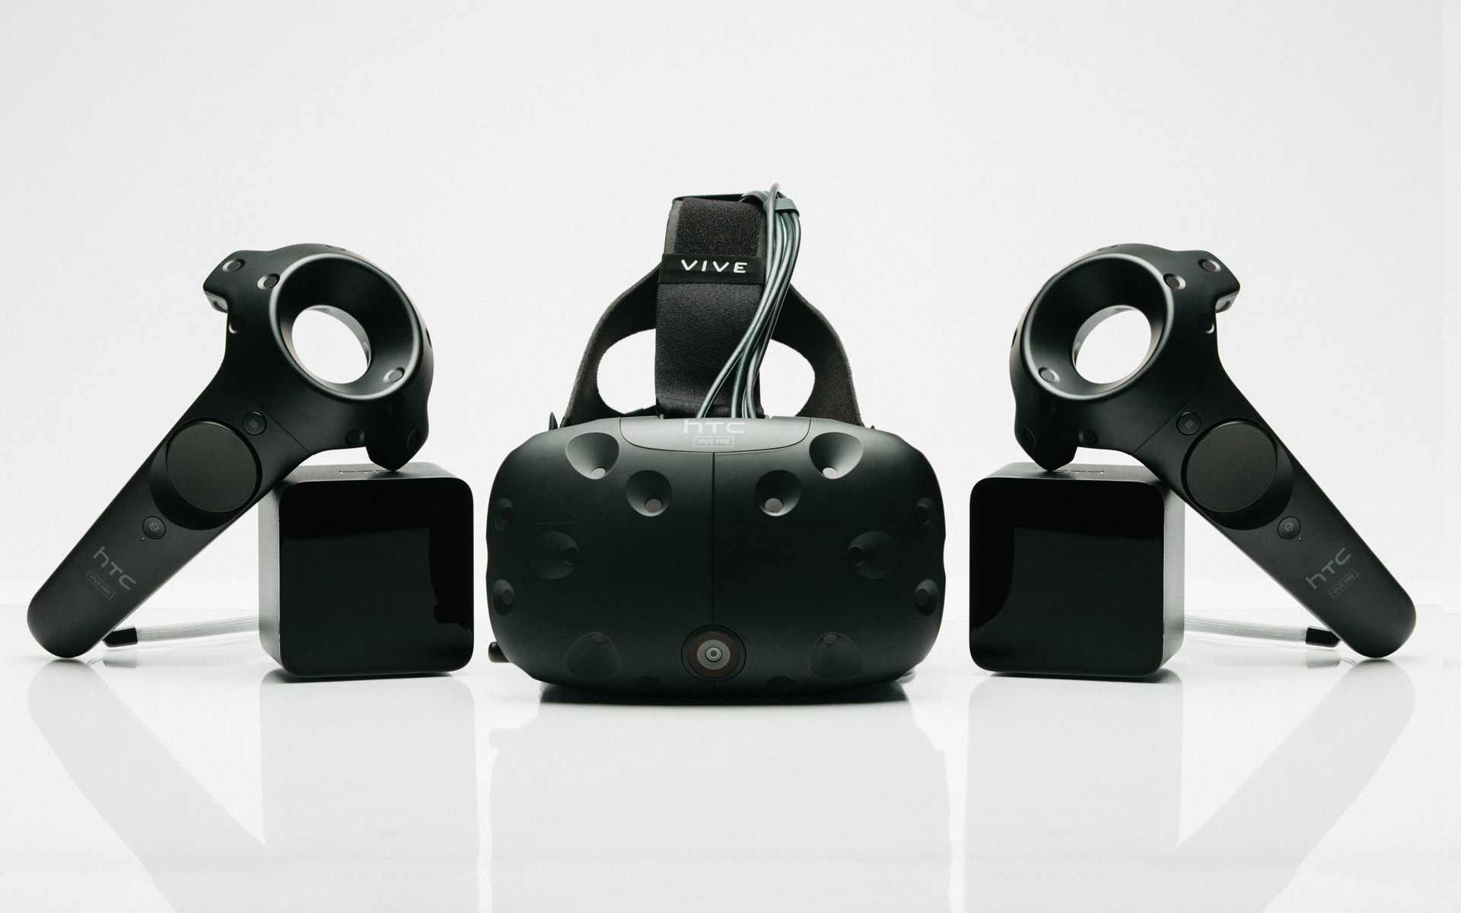
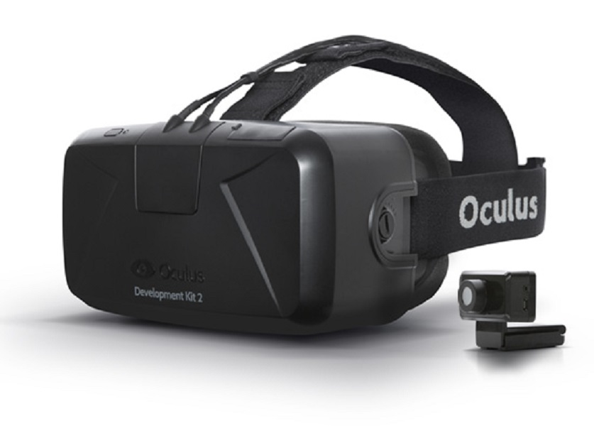
Hardware considerations
HTC Vive
360º View
Position and Hand Tracking
Oculus Rift
Head Tracking
No 360º View
Both are not mobile, and require powerful PC hardware.

Slide 6
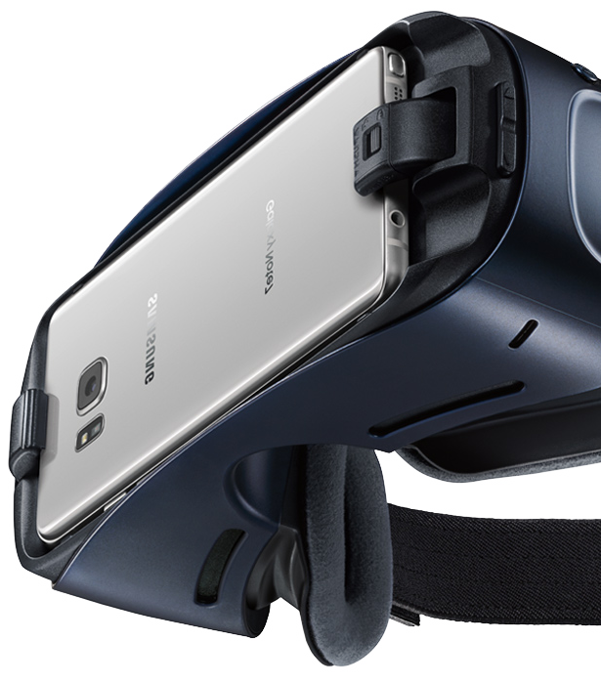
Gear VR
Mobile
Affordable
360º View
Oculus SDK

Slide 7

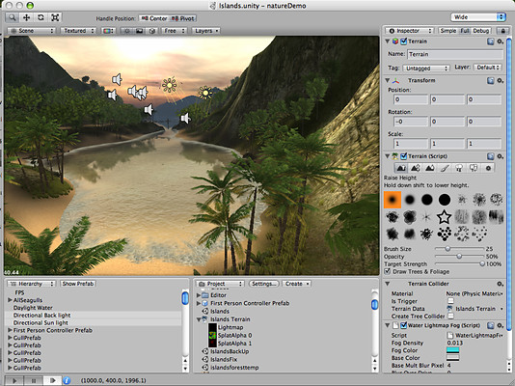
Software
Oculus, Android, & Unity
Solid Codebase and Documentation.
Vibrant Developer Community
Cross-Platform Support.

Slide 8
Research Methods
Asad Ashur

Slide 9
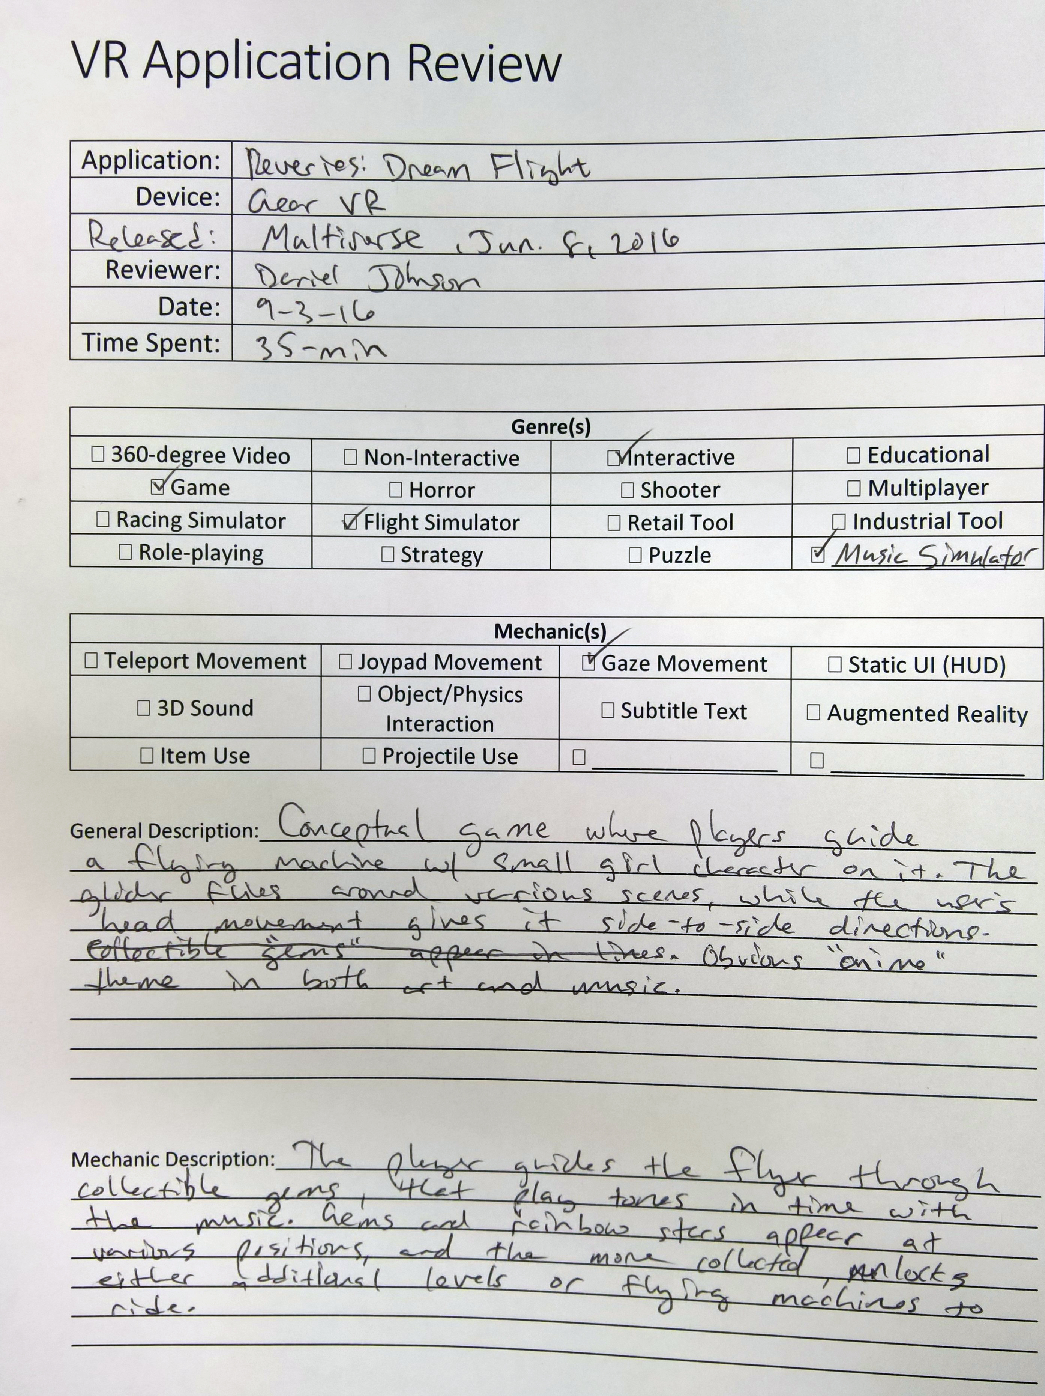
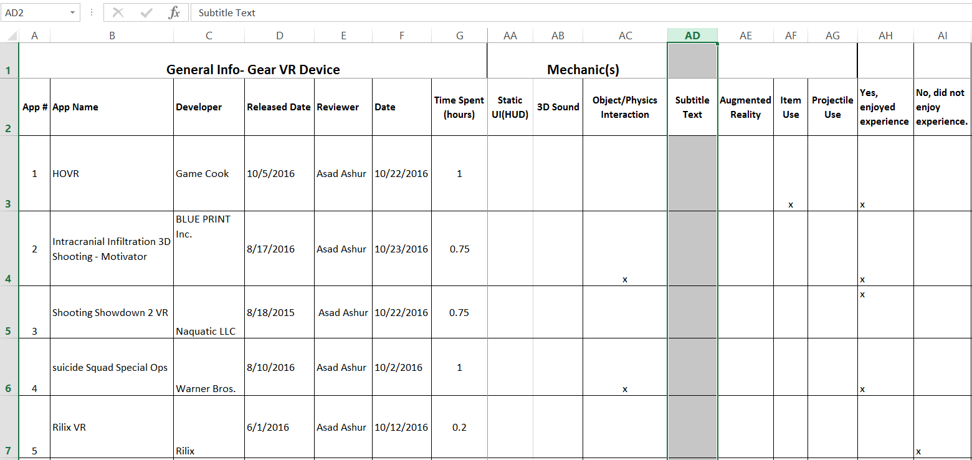
Data Collection
Identified Relevant Data Points
Developed Entry Form
Organized Data in Excel Sheet

Slide 10
Evaluation
App Name | Pros | Cons | Rating
HOVR | Objects & obstacles Jump and slide on rails Ride skateboard | Nitro does not fly Does not have many controls Does not move in all directions | 4.5
Motivator | Simple and easy to play Being able to upgrade the ship with money There are levels Ion beam attack | Limited direction movement Two items only Few # of enemies | 4
Collected Subjective Review Data
Relate Genres/Mechanics With Rating
Used as Reference for Team’s Application Design

Slide 11

Data Storage
Relational Database
Greater Visibility
Analysis and Relation.

Slide 12
Data entry and analysis

Slide 13
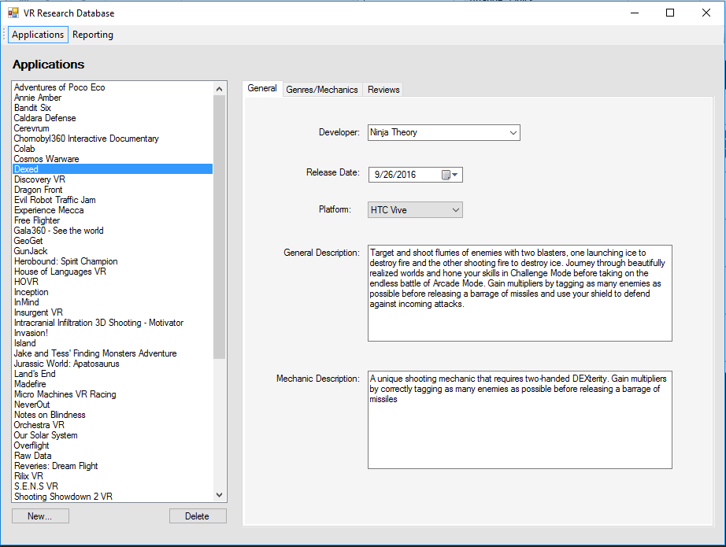
Database application

Slide 14
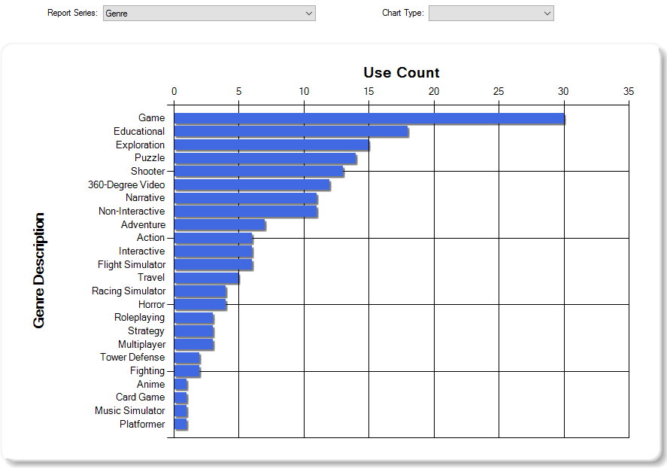
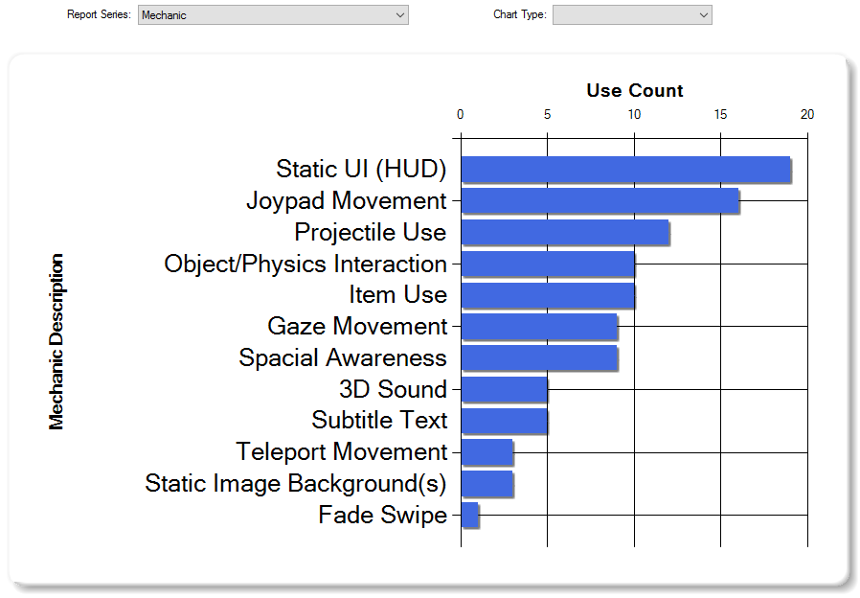
Genres and mechanics

Slide 15
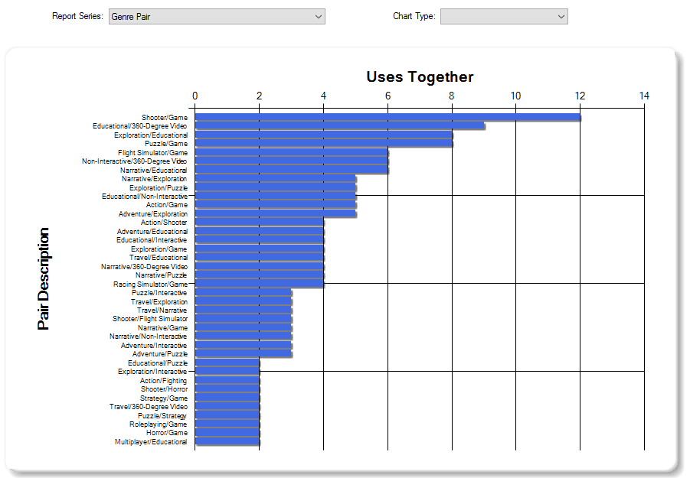
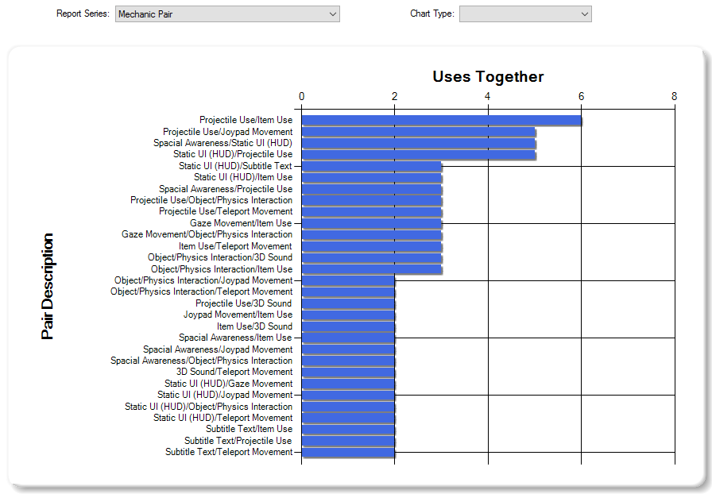
Genre/mechanic pairs

Slide 16
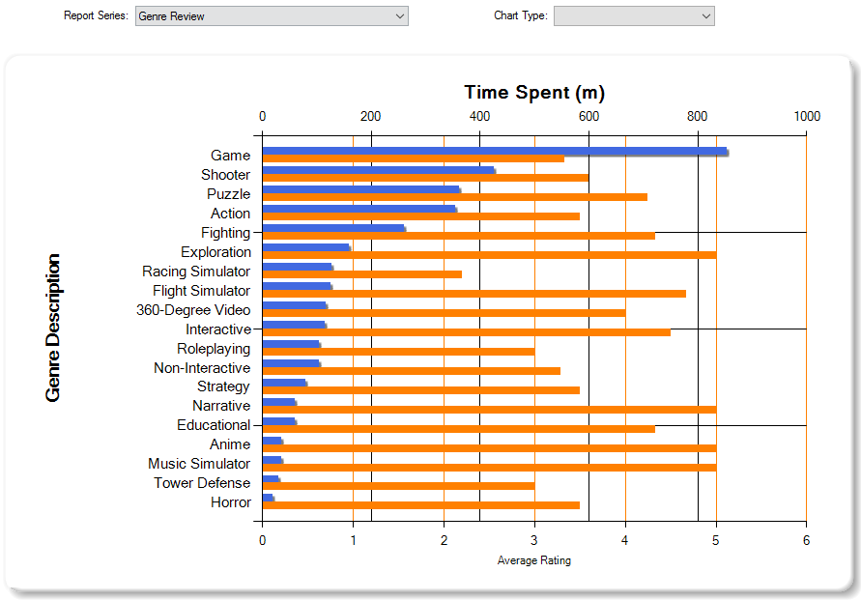
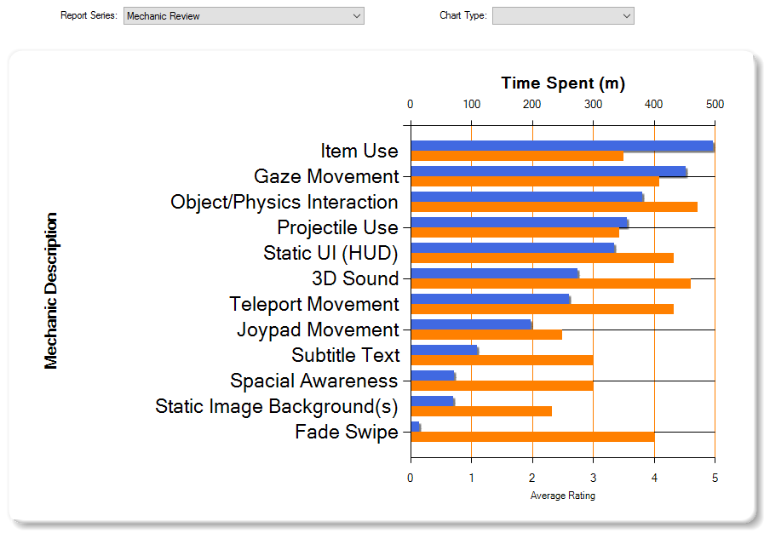
Review data

Slide 17
Conclusion

Slide 18
VR Do’s and don’ts
First-Person Characters
Panoramic Scenes
World-space User Interfaces
Gaze Interaction
Narrative Immersion
Too Near Objects
Require Quick Head Movements
Mono-Directional View
Repetitive Trackpad Use
Unexpected View Movement
DO
DON’T

Slide 19
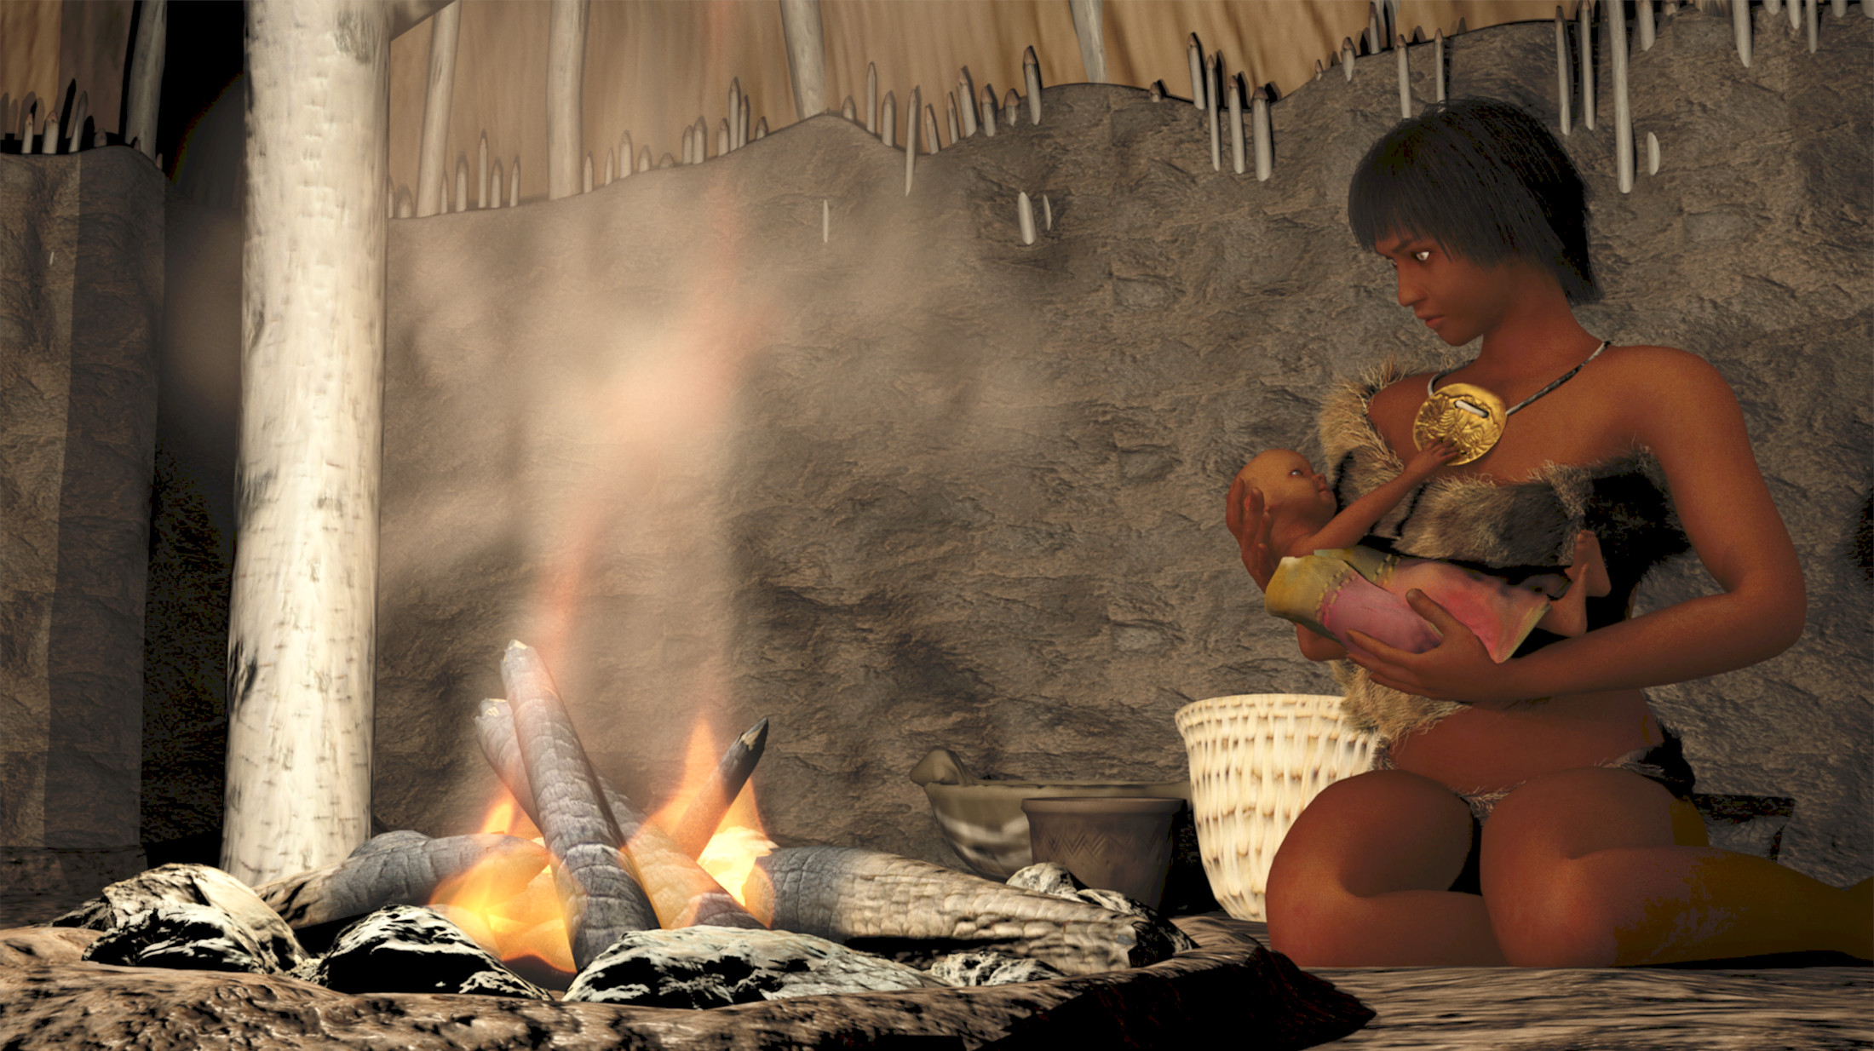
Prototype design
Historical/Exploration/Educational
Panoramic Environment
Static Camera
Interactive Objects
World-space Textual Elements
Mississippian 3D Scene
(courtesy of IPFW VCD Department)

Slide 20
Implementation Plan
Semester Two
Use research data and analysis to drive application vision.
Present a comprehensive Design Document for implementation.
Use iterative approach - continually build existing prototype architecture.
Test integration of AR plugin (Vuforia) to gain motion tracking with Gear VR.

Slide 21
Thank you!
Dr. Hayes
Dr. Kim
CS Department (Hardware and Facilities)

